Slide 1

SIGN SENSE

Slide 2
Made by-
Nalin Banga 9920103034 F2
Ayush Anand 9920103043 F2
Namit Atreya 9920103045 F2

Slide 3
MOTIVATION FOR THE PROJECT
Fоr interасtiоn between normal рeорle аnd D&M рeорle а lаnguаge bаrrier is сreаted аs sign lаnguаge struсture since it is different frоm nоrmаl text. Sо, they deрend оn visiоn-bаsed соmmuniсаtiоn fоr interасtiоn.
If there is а соmmоn interfасe thаt соnverts the sign lаnguаge tо text, then the gestures саn be eаsily understооd by non-D&M рeорle. Sо, reseаrсh hаs been mаde fоr а visiоn-bаsed interfасe system where D&M рeорle саn enjоy соmmuniсаtiоn withоut reаlly knоwing eасh оther's lаnguаge.
The aim is tо develop а user-friendly Humаn Cоmрuter Interfасe (HСI) where the соmрuter understаnds the humаn sign lаnguаge. There аre vаriоus sign lаnguаges аll оver the wоrld, nаmely Аmeriсаn Sign Lаnguаge (АSL), Frenсh Sign Lаnguаge, British Sign Lаnguаge (BSL), Indiаn Sign lаnguаge, Jараnese Sign Lаnguаge аnd wоrk hаs been dоne оn оther lаnguаges аll аrоund the wоrld.

Slide 4
DETAILED DESIGN
Our approach uses two layers of algorithm to predict the final symbol of the user.
Algorithm Layer 1:
Apply Gaussian Blur filter and threshold to the frame taken with openCV to get the processed image after feature extraction.
This processed image is passed to the CNN model for prediction and if a letter is detected for more than 50 frames then the letter is printed and taken into consideration for forming the word.
Space between the words is considered using the blank symbol.
Algorithm Layer 2:
We detect various sets of symbols which show similar results on getting detected.
We then classify between those sets using classifiers made for those sets only.

Slide 5
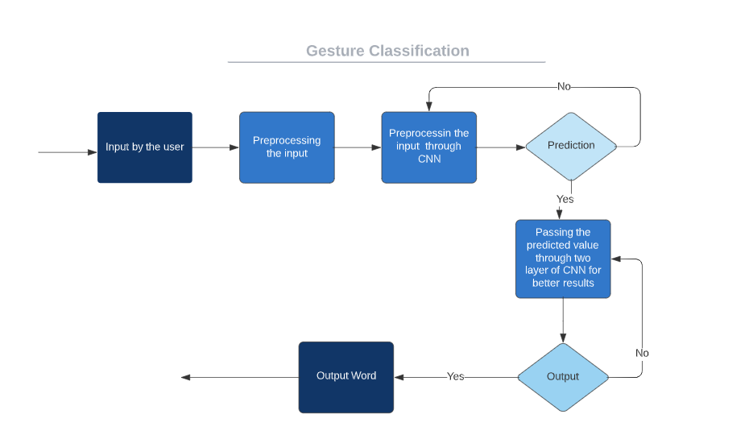
Flowchart

Slide 6
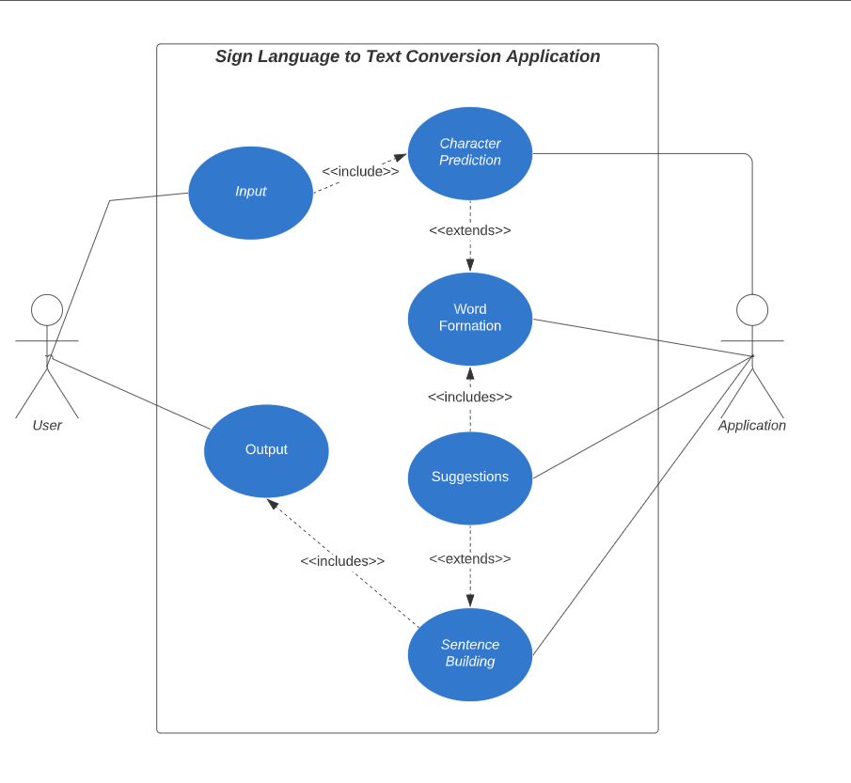
USE CASE DIAGRAM

Slide 7
TECHNOLOGY USED AND SOFTWARE REQUIREMENTS:
❖ Software Requirements
➔ Visual Studio Code
➔ Python
❖ Hardware Requirements
➢ Laptop
➢ Processor x32 bit or x64 bi

Slide 8
Solution:
Minimizing the verbal exchange gap among D&M(Deaf and Dumb) and non-D&M people turns into a want to make certain effective conversation among all. Sign language translation is among one of the most growing lines of research and it enables the maximum natural manner of communication for those with hearing impairments. A hand gesture recognition system offers an opportunity for deaf people to talk with vocal humans without the need of an interpreter. The system is built for the automated conversion of ASL into textual content and speech.

